Slide 1
R & D Project-Group 22
AI-based framework to analyze and predict mid-line channel migration of Subansiri River using remote sensing & GIS
Supervisors: Dr Thota Sivasankar
Dr Ratna Sanyal
Team:Ishika Shruti
Jatin Sharma
Anayna Nidhi Singh
Notes:
Good Morning respected panel members, we are group 22, and our topic is an AI-based framework to analyze and predict mid-line channel migration of Subansiri River using remote sensing & GIS.

Slide 2
Objective
To investigate the changes in mid-line channel of Subansiri River using Remote Sensing & GIS.
Predict mid-line channel of Subansiri River using AI and ML.
Notes:
Our first objective is to Develop an AI-based framework for the accurate mapping of the river channels. Secondly, To investigate the changes in the mid-line channel of Subansiri River using remote sensing & GIS. And finally, Predict the midline channel of Subansiri River using AI and ML.

Slide 3
Problem statement
High amounts of money and lives can be saved by accurate prediction of flood prone areas around Subansiri river.
Planning of river projects, irrigation projects and hydropower system around the areas surrounding Subansiri river.
Notes:
So after discussing the 3 objectives, let's have a look at the problem statement that we worked on.
There is a need to predict the flood-prone areas around the subansiri river as high amounts of money and lives can be saved by this accurate prediction.
Secondly, there is a need for planning river projects, irrigation projects, and hydropower systems in the areas surrounding the subansiri river. AND, predicting the flow of the midline channel of the subansiri river can lead to the development of these projects.

Slide 4
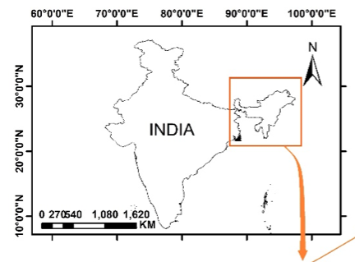
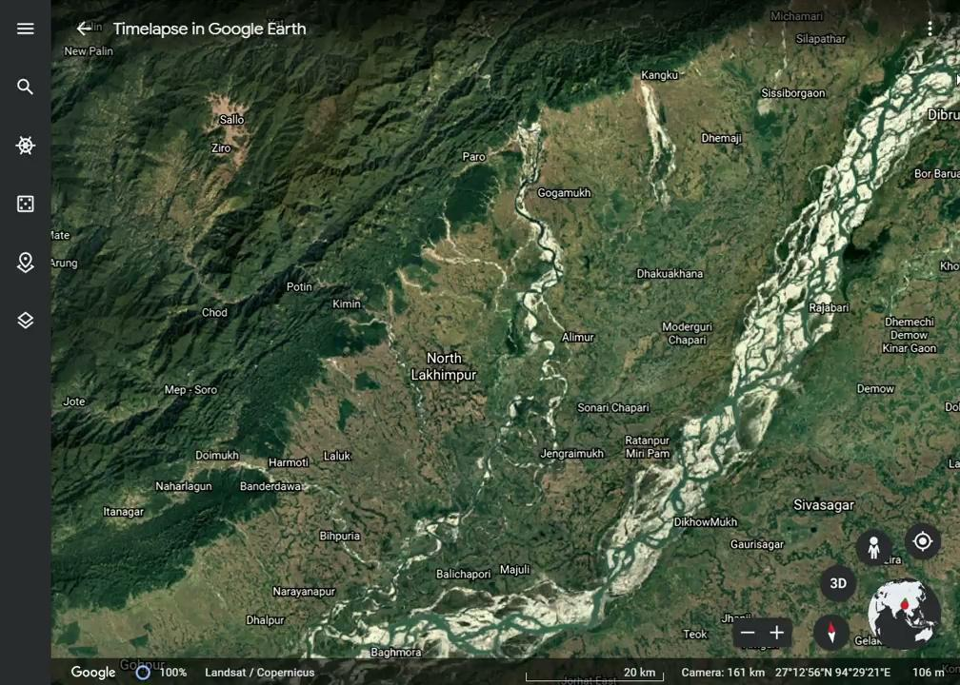
Introduction
The Subansiri is one of the principal tributaries of the Brahmaputra river.
The geographical coordinates are:
28.5º and 28.25º latitude.
93.15º and 94.20º longitudes.
Image source : https://a-a-r-s.org/proceeding/ACRS2020/6salw3.docx
Notes:
The Subansiri River is the largest tributary of the extensive Brahmaputra river. Our region of interest was the part of the Subansiri river where it enters the flood plains till the point it merges with the Brahmaputra river. The considered district’s geographical coordinates are 28.25º and 28.50º latitudes, 93.15º and 94.20º longitudes.

Slide 5
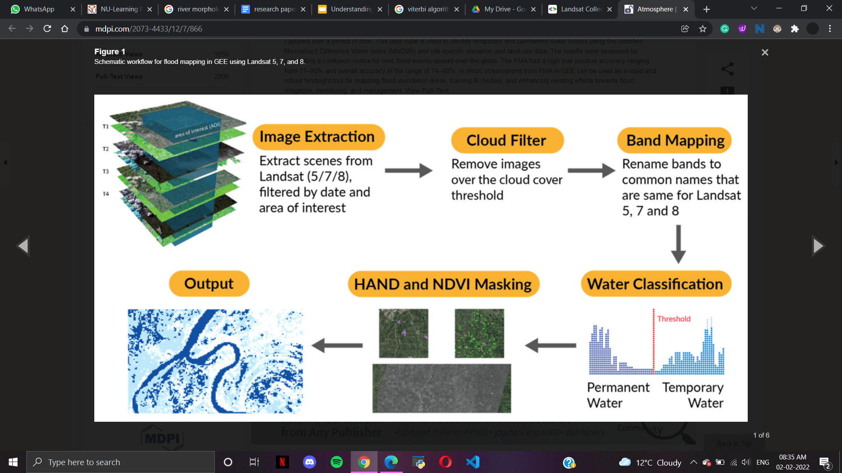
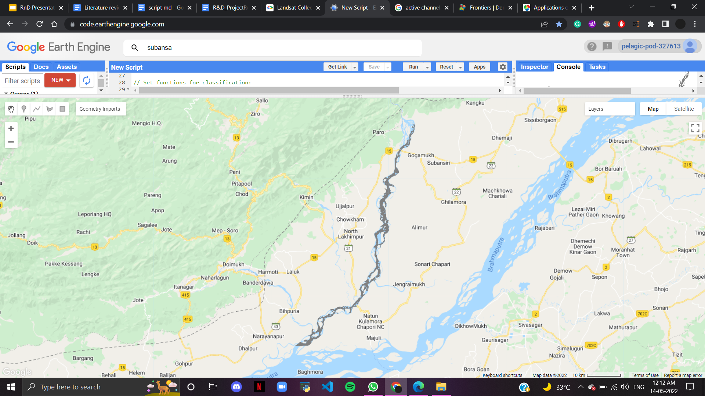
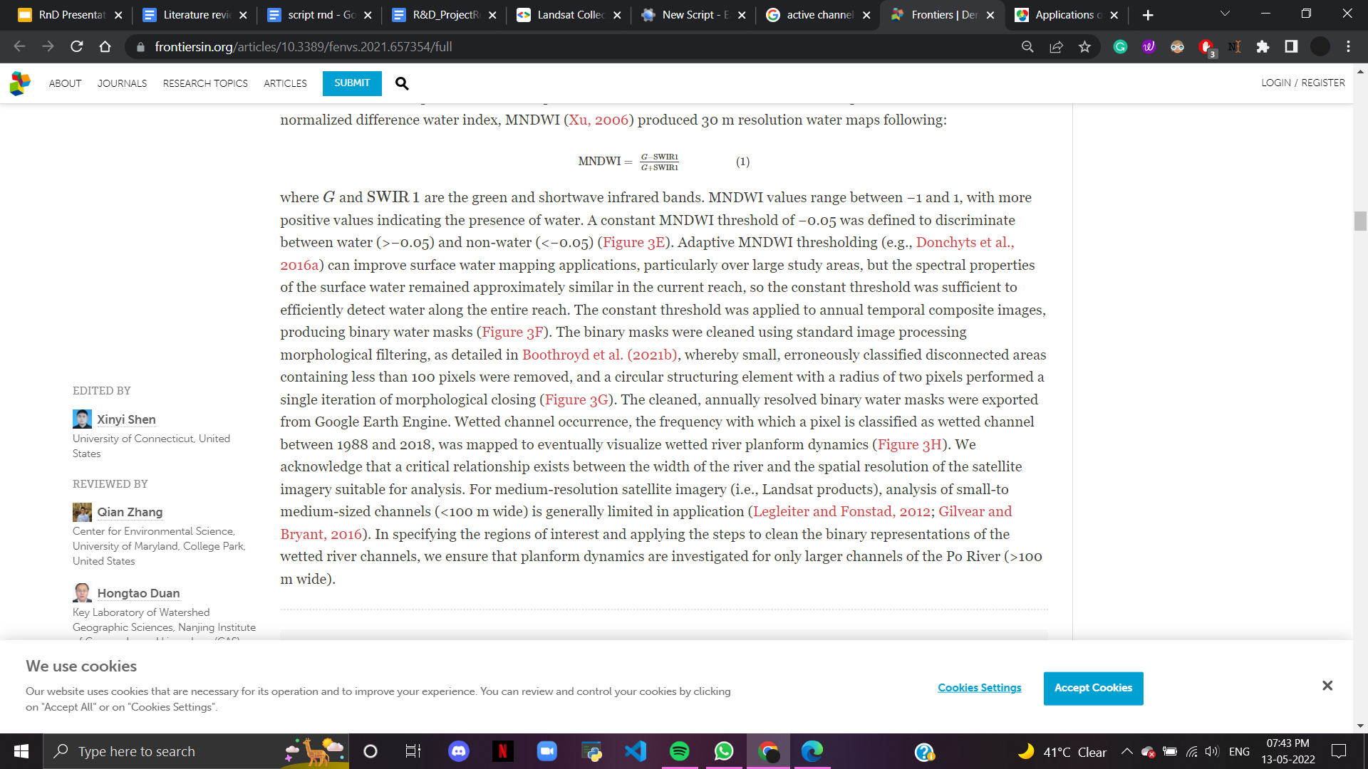
Methodology
Georeferencing
Georeferencing of Satellite Images from Landsat 5/7/8(automatically)
River masking
MNDWI dataset
Notes:
Based on the understanding of the various research papers we devised a methodology to go about our project .our 1st and foremost step this is done by extraction of images from the google earth engine, where we used the Landsat 5,7,8 datasheets and filtered them date and time frame. then we applied the function of georeferencing where we will basically be took a digital image and adding geographic information to it. After this, we used cloud filtering to filter out cloud cover to remove any noise from our image, then we use band mapping to rename the bands that are common for Landsat 5,7, and 8. After this, The modified normalized water index (MNWDI) filter was applied to produce a water map with the formula where G and SWIR1 indicate the green and shortwave, infrared bands. A constant threshold was applied to images to generate a binary water mask. The binary mask was cleaned using standard image processing morphological filters and was exported from Google Earth Engine under the name of the active binary masked layer.

Slide 6
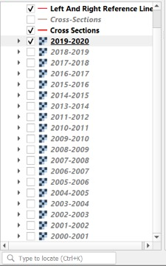
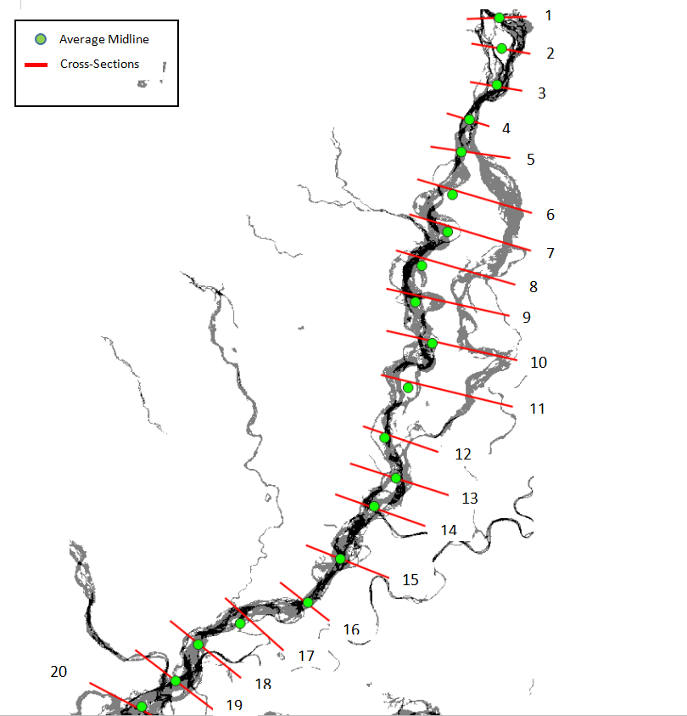
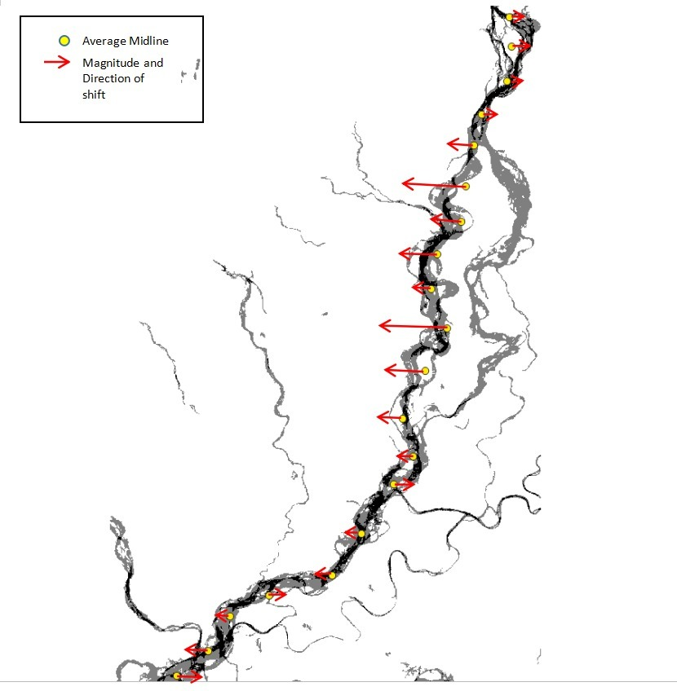
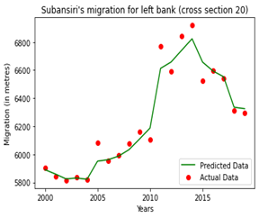
Methodology
Division of Subansiri River into 20 cross sections from 2000 to 2020
Analysis of river flow using average midline values
Calculating Midline channels
Machine Learning implementation

Slide 7
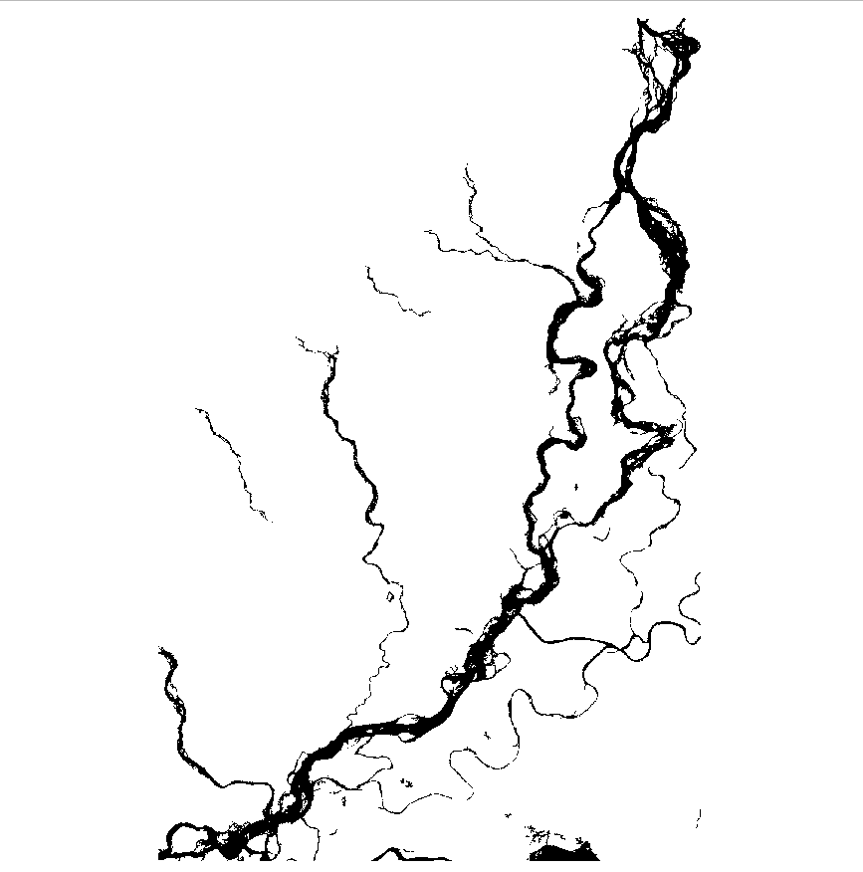
Demonstration
Full methodology of workflow in QGIS
Superimposing images with 2000 as Base year.
Changing the transparency for better analysis.
Creating reference line for left and right bank, midline and value calculation.

Slide 8
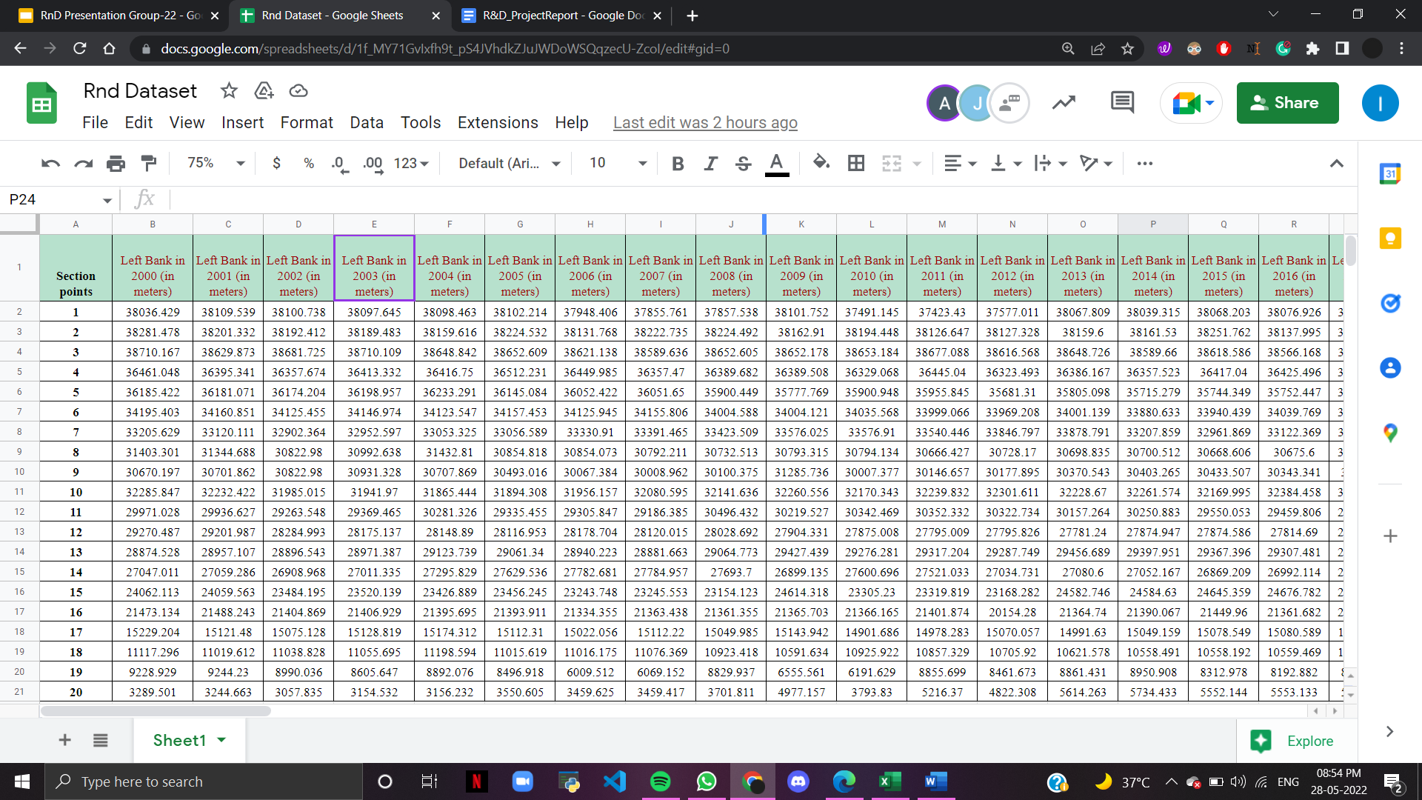
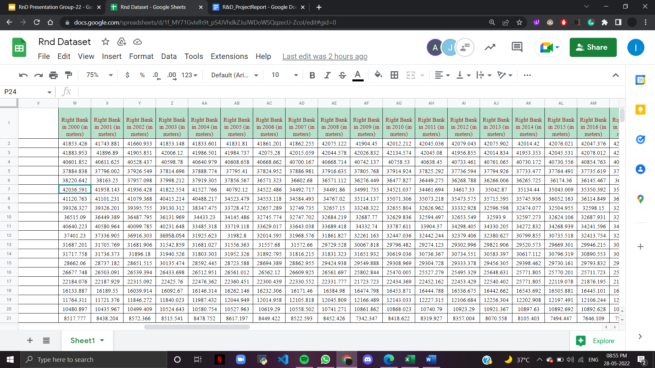
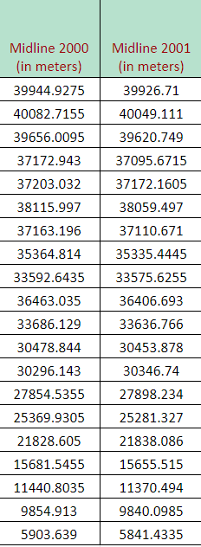
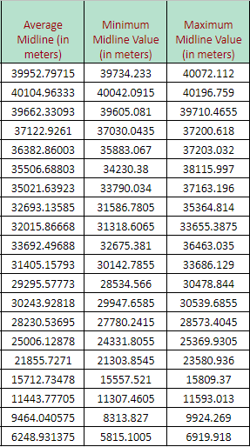
Midline value=
(Right bank-Left bank)
2
Midline value calculation
Notes:
As u can see from the slide, the left and right bank values were computed and then we calculated the midline of the river channel which was done by subtracting the distance of the right bank from left bank for a given year and dividing it by 2.this process was done for all the 20 cross sections for all 20 years data. In addition, we also calculated the average midline and maximum and minimum midline values given a particular cross-section for further analysis.

Slide 9
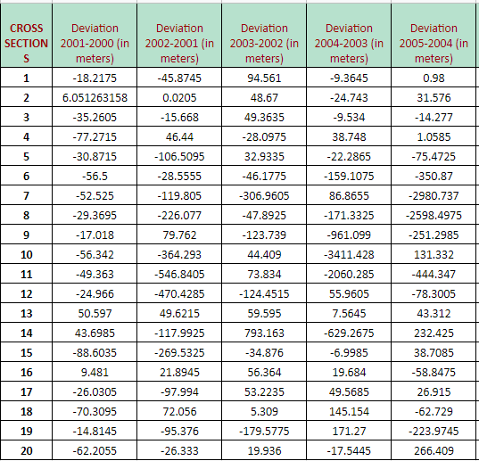
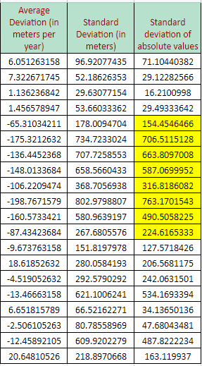
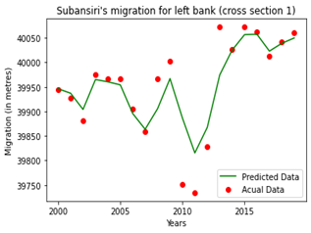
Analysis of river flow using average midline values using deviation
Machine Learning implementation on the cross sections.
Notes:
After the midline values were calculated statistically and plotted into our river channel ,we analyzed the flow of the river using the concept of deviation. The deviation is the change in the flow of the river and this was calculated by Subtracting the midline value of the previous year from the current year to see the change in river flow. This deviation was indicated with the (+) AND (-) values, where (+) suggested the river moving to the left side and (-) indicated right side movement. Once the deviation for all years was collected, we calculated the average deviation and standard deviation for all the cross-sections for analysis. This will be explained further in the result and analysis.Finally, To assess the midline position of the channel for 2020 using historical values from the digitized records obtained, we applied the Random Forest Regression technique to the collected data. we calculated the midline channel in 2020 at 20 different cross-sections with the actual and predicted values depicted via graph.

Slide 10

Tools and Technologies
Geographic Information System (GIS)
“A geographic information system (GIS) is a system that creates, manages, analyzes, and maps all types of data.”
It aids in a better understanding of geographical patterns and relationships by connecting seemingly unconnected data.
2) Remote Sensing
Remote sensing, which is one of the most often utilized techniques for data acquisition, provides the data that a GIS system uses.
It is the process of detecting and monitoring an area’s physical features from a distance by measuring its reflected and emitted radiation.

Slide 11


Tools and Technologies
3) Google Earth Engine
Google Earth Engine is a cloud-based geospatial analysis platform that combines a multi-petabyte catalog of satellite imagery and geospatial datasets with planetary-scale analysis capabilities.
4) Google Colaboratory
Google Colab or Colaboratory is a cloud-based framework that provides free access to Jupyter notebook and require no configuration or pre-installation of any software, with easy accessibility.

Slide 12

Tools and Technologies
5) QGIS
QGIS is a cross-platform desktop geographic information system application that allows you to browse, edit, print, and analyze geographical data for free.
6) Random Forest Regression
Random forest is a supervised learning algorithm. It builds a “forest” which is an ensemble of decision trees mostly trained with the “bagging” method.
The general logic behind this bagging method is that a combination of learning models increases the overall result.

Slide 13
Results
Link to the dataset we created-
https://docs.google.com/spreadsheets/d/1f_MY71GvIxfh9t_pS4JVhdkZJuJWDoWSQqzecU-ZcoI/edit#gid=0

Slide 14
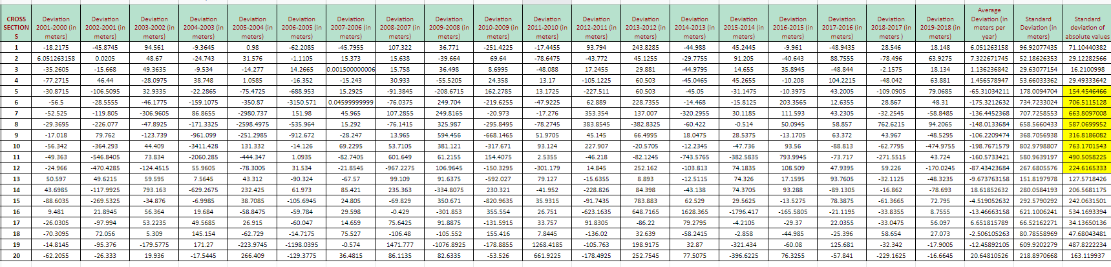
Results
Table 3: Deviations calculated for each cross-section over the years and its average, standard, and absolute standard deviation for river flow analysis.

Slide 15
Result and analysis-River Flow prediction
Fig:River shift observed by statistical analysis of average midline showcased from the year 2000 and 2020

Slide 16
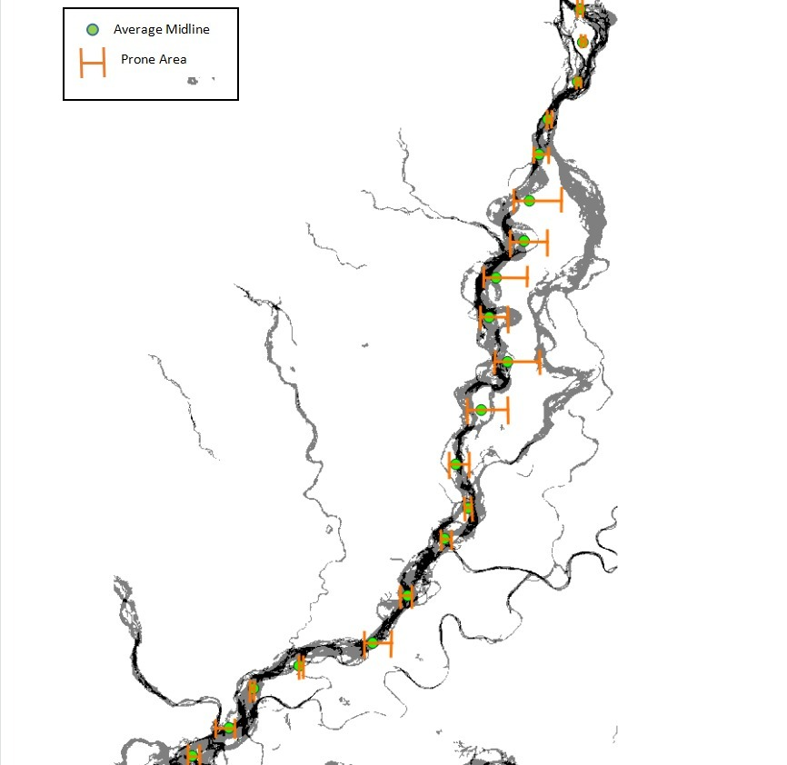
Result and analysis-Region of river deviation
Fig: Affected areas around the river as observed by plotting the maximum and minimum midline value from the year 2000 to 2020

Slide 17
Result and analysis- Machine Learning Implementation
Using Remote Sensing, GIS and statistical methods
We found out the average position of the midline along with the magnitude and direction of the midline.
We also found out the areas prone to flooding according to the analysis of midline deviation from year 2000 to 2019.
Using Machine Learning techniques to the previously obtained calculations and results
We found out the predicted values of the position of the midline channel of Subansiri river for the year of 2020 and then compared it with the actual position of the midline for the year of 2020.

Slide 18
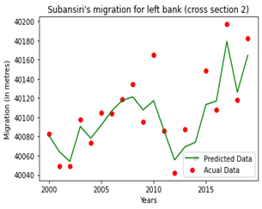
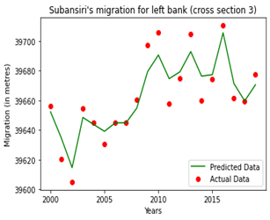
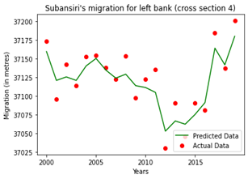
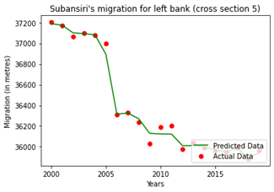
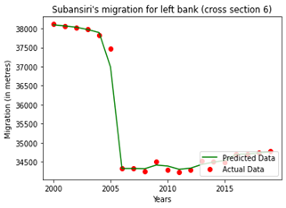
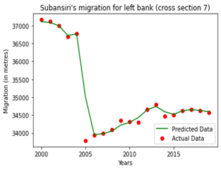
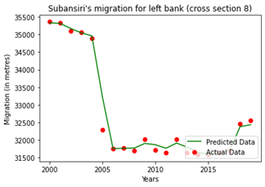
Results obtained after training the model with Random Forest Regression
Cross section-1
Cross section-2
Cross section-3
Cross section-4
Cross section-5
Cross section-6
Cross section-7
Cross section-8

Slide 19
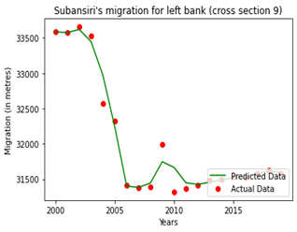
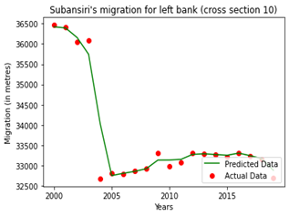
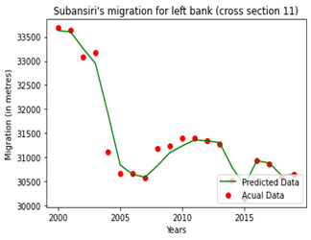
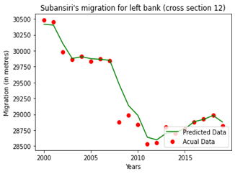
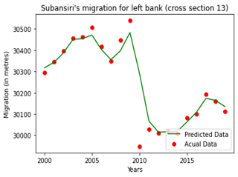
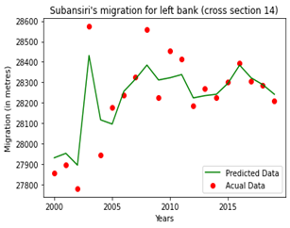
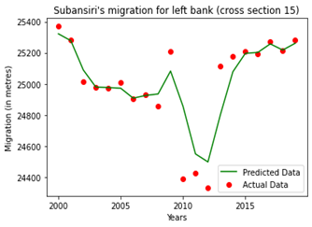
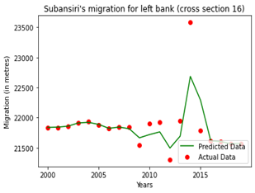
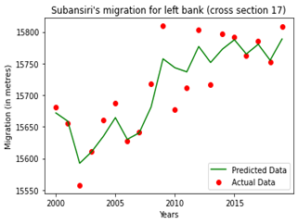
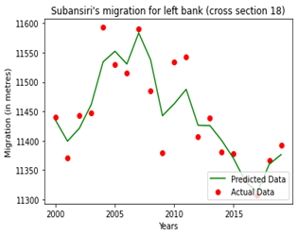
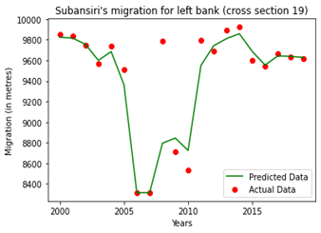
Cross section-9
Cross section-10
Cross section-11
Cross section-12
Cross section-13
Cross section-14
Cross section-15
Cross section-16
Cross section-17
Cross section-18
Cross section-19
Cross section-20

Slide 20

Implementation of Random Forest Regression

Slide 21
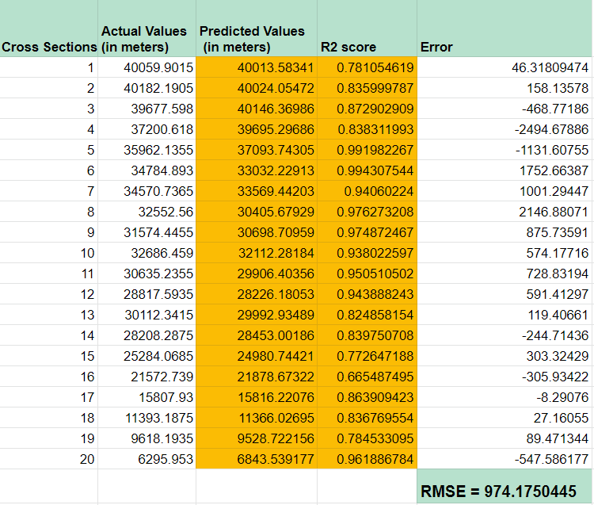
Results after applying Random Forest Regression
Actual values = actual position of the midline of the river for the year 2020
Predicted values = predicted position of midline of the river for the year 2020
R² score = The R² score is a statistical description of how the samples fit along a linear model.
Error= Actual values - Predicted values
RMSE = (Square root of the sum of squares of error values) / (total number of values)

Slide 22
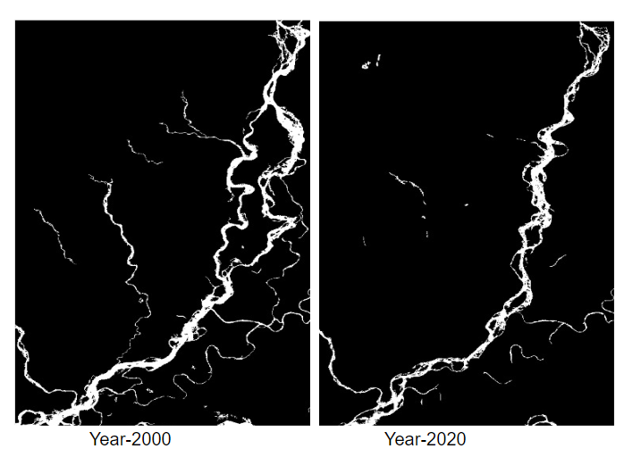
Results and analysis
The midline of the river channel is migrating towards the west overall.
2) The river projects should not be planned near the regions marked in orange surrounding cross sections 5 to 11 as it is the most prone to flooding.
3) In 2000 the channel was divided into two sub channels and throughout the years it merged into the main channel due to midline channel migration towards the left bank(west).
Cross section 5
Overall migration towards the left
Cross section 11
(Satellite images obtained from GEE)

Slide 23
Results and analysis
4) The random forest regression model gives the best prediction for cross section 5 with R² score of 0.9943.
5) The random forest regression model gives the worst prediction for cross section 16 with R² score of 0.6654.
6) The calculated RMSE between the actual values of position of midline and the predicted values of position of midline for the 20 cross sections for 2020 is: 974.17
Cross section 5: best fit
Cross section 16: worst fit
R² score: 0.9943
R² score: 0.6654

Slide 24

Future Scope
More extensive climatic studies, morphology changes, rainfall pattern, erosion/deposition data, hydrologic data can be taken into consideration for more accurate predictions.
Applying more robust AI/ML models to our dataset.
Automating the identification of river and river banks by making use of region growing method of Computer Vision/AI.
Automating the calculation of the threshold value for MNDWI calculation for determining water and non water surfaces.
The development of improved
data mining techniques and the use of higher quality satellite images.
Notes:
Understanding of various techniques and methods to acquire information about spatial objects using Remote Sensing.
Different factors that influence evolutionary trajectories of a river.
Past and current understanding of river delta morphology changes using remote sensing to understand how morphology techniques that work best for a certain terrain cannot be best suited for another terrain.
Application of NDWI helps in strongly enhancing the water features so that we can have a better understanding of the temporal changes of the river morphology.
Understanding of different models and approaches to apply change detection.

Slide 25
Deliverables of the project
Able to investigate the changes in mid-line channel of Subansiri River using remote sensing & GIS.
Able to predict the position of midline channel of Subansiri River for the year 2020 using AI/ML where we made use of Random Forest Regression.
Detected the flood prone areas on the basis of observations from Remote Sensing, GIS, ML and statistical techniques.
Able to device a solution to solve the problem of loss of land, money and lives around the Subansiri river and the planning of river projects/industrial projects by detection of flood prone areas.

Slide 26
References
Mithun Deb and Celso Ferreira “Planform channel dynamics and bank migration hazard assessment of a highly sinuous river in the north-eastern zone of Bangladesh”,May 2014 Environmental Earth Sciences 73(10):1-11,DOI:10.1007/s12665-014-3884-3.
Nones, M. (2021),”Remote sensing and GIS techniques to monitor morphological changes along the middle-lower Vistula river, Poland”.International Journal of River Basin Management, 19(3), 345-357.
Piégay, H., Arnaud, F., Belletti, B., Bertrand, M., Bizzi, S., Carbonneau, P., ... & Slater, L. (2020). Remotely sensed rivers in the Anthropocene: State of the art and prospects. Earth Surface Processes and Landforms, 45(1), 157-188.
Shi, W., Zhang, M., Zhang, R., Chen, S., & Zhan, Z. (2020). Change detection based on artificial intelligence: State-of-the-art and challenges. Remote Sensing, 12(10), 1688.
Munasinghe, D., Cohen, S., & Gadiraju, K. (2021). A Review of Satellite Remote Sensing Techniques of River Delta Morphology Change. Remote Sensing in Earth Systems Sciences, 1-32.
Chinmoyee Gogoi , 2,Dulal C. Goswami 1,2,Department of Environmental Science Gauhati University, Guwahati – 781014, Assam, India.A study on bank erosion and bank line migration pattern of the subansiri river in assam using remote sensing and gis technology,ISSN(e): 2319 – 1813 ISSN(p): 2319 – 1805
Dipsikha Devi, A study on channel migration of Subansiri River basin

Slide 27
Thank you

Slide 28
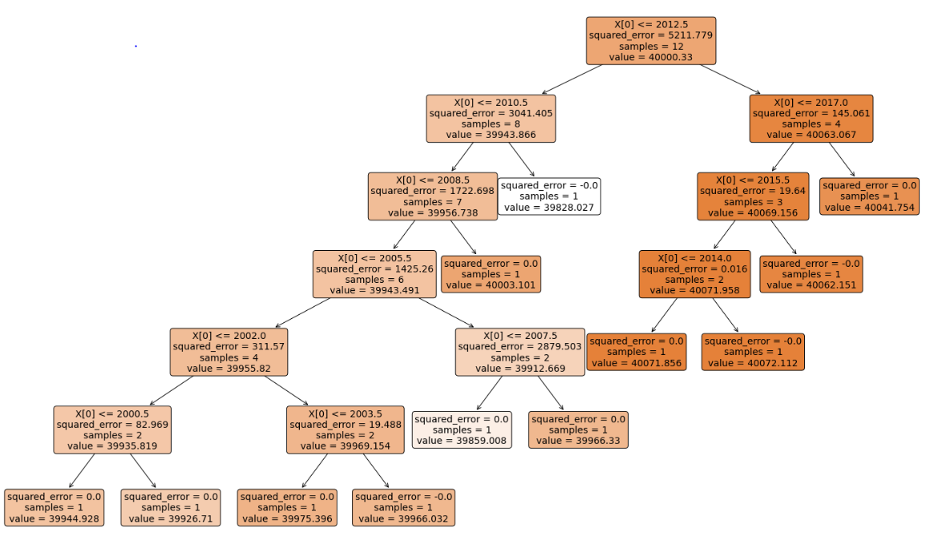
Visualisation of our Random Forest Tree
Example of visualisation of a random forest tree generated via code for the 1st cross section.
The predicted value of the position of the midline from the reference line is: 40013.58 meters

Slide 29
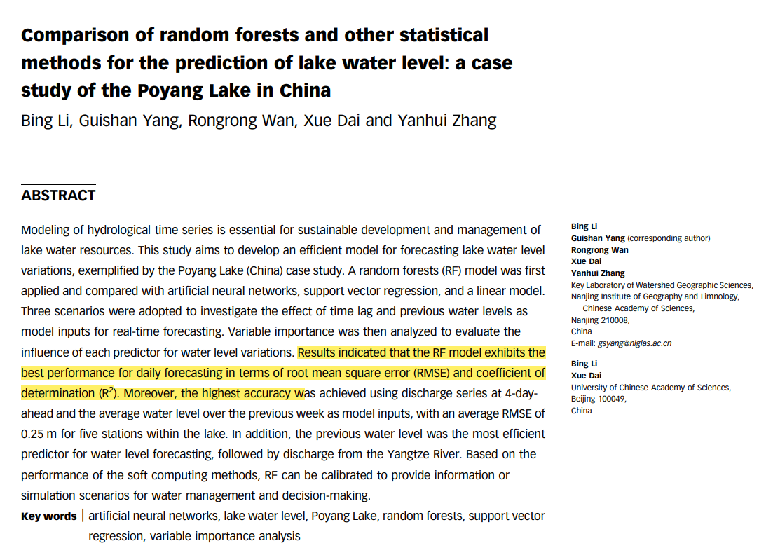
Random forest regression model-Why did we use this?
Comparison of random forests and other statistical methods for the prediction of lake water level: a case study of the Poyang Lake in China Bing Li, Guishan Yang, Rongrong Wan, Xue Dai and Yanhui Zhang
Monthly Streamflow Prediction Based on Random Forest Algorithm and Phase Space Reconstruction Theory To cite this article: Feng Peng et al 2020 J. Phys.: Conf. Ser. 1637 012091
https://iopscience.iop.org/article/10.1088/1742-6596/1637/1/012091/pdf
https://hess.copernicus.org/preprints/hess-2020-305/hess-2020-305.pdf
https://watershed.ucdavis.edu/shed/lund/students/EllieWhiteMSthesis.pdf
https://www.tandfonline.com/doi/full/10.1080/02626667.2019.1680846
https://agupubs.onlinelibrary.wiley.com/doi/abs/10.1029/2018WR023254

Slide 30
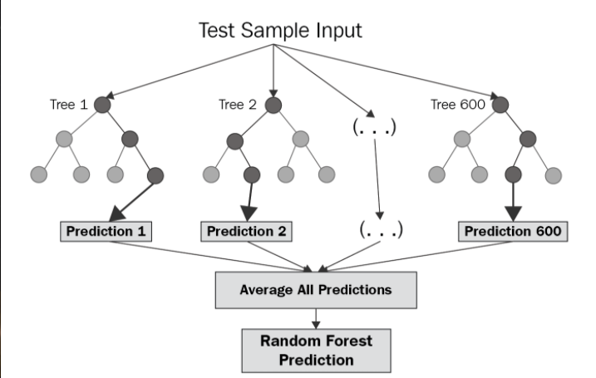
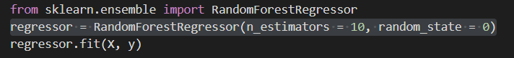
What is random forest
We are creating 10 trees

Slide 31
Random forest vs decision tree
The critical difference between the random forest algorithm and decision tree is that-
Decision trees are graphs that illustrate all possible outcomes of a decision using a branching approach.
In contrast, the random forest algorithm output are a set of decision trees that work according to the output.
Random forest algorithm works well because it aggregates many decision trees, which reduce the effect of noisy results, whereas the prediction results of a single decision tree may be prone to noise.

Slide 32
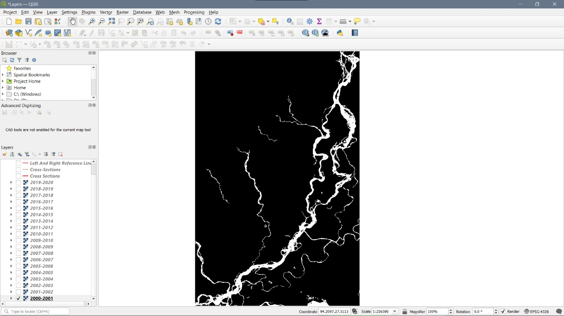
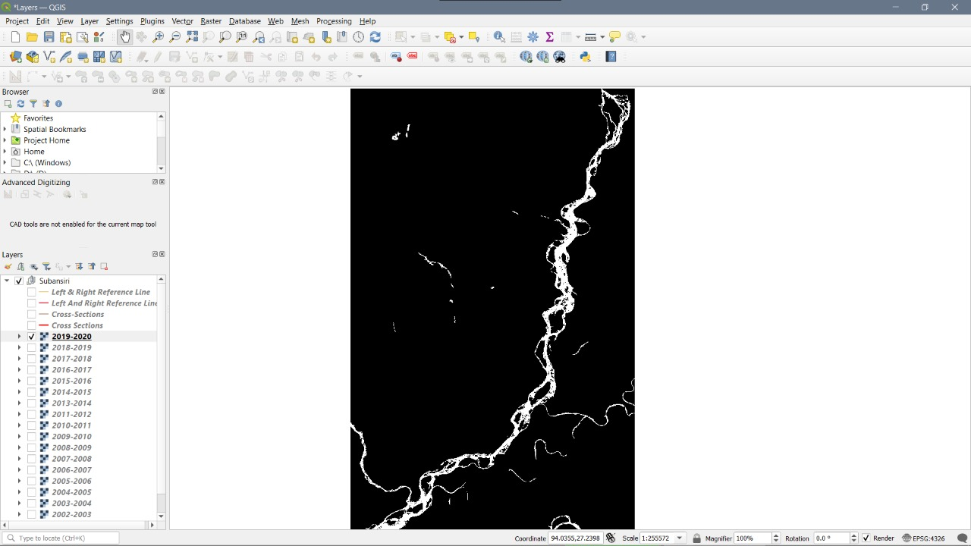
Year-2000
Year-2020

Slide 33
Code for implementation of Random Forest Regression
# Random Forest Regression
import numpy as np
import matplotlib.pyplot as plt
import pandas as pd
dataset = pd.read_excel('rndmigrationdataset.xlsx')
print(dataset)
dataset.isnull()
dataset.dropna(axis = 1, inplace=True)
y = dataset.iloc[0,1:19].values
print(y)
print(type(y))
X = np.array([2000,2001,2002,2003,2004,2005,2006,2007,2008,2009.2010,2011,2012,2013,2014,2015,2016,2017,2018])
print(X)
print(type(X))
X = X.reshape(-1, 1)
y = y.reshape(-1,1)
from sklearn.ensemble import RandomForestRegressor
regressor2 = RandomForestRegressor(n_estimators = 10, random_state = 2)
regressor2.fit(X, y)
X_predict2 = np.array([11])
X_predict2 = X_predict2.reshape(-1,1)
y_predict2 = model.predict(X_predict2)
import pandas as pd
from datetime import datetime, timedelta
from matplotlib import pyplot as plt
from matplotlib import dates as mpl_dates
import matplotlib.ticker as plticker
loc = plticker.MultipleLocator(base=5.0)
fig, ax = plt.subplots()
ax.xaxis.set_major_locator(loc)
ax.scatter(X, y, color = "red")
ax.plot(X, regressor2.predict(X), color = "green")
plt.title("Subansiri's migration for left bank (cross section 9)")
plt.xlabel("Years")
plt.ylabel("Migration (in metres)")
plt.legend(["Predicted Data", "Actual Data"], loc ="lower right")
plt.show()
print(regressor2.predict(X))
from sklearn.metrics import r2_score
r2_score(y,regressor2.predict(X))
a = np.array(2020)
a=a.reshape(1,-1)
model.predict(a)

Slide 34
What is r2 score? ” …the proportion of the variance in the dependent variable that is predictable from the independent variable(s).
The R2 score is a statistical description of how the samples fit along a linear model.
Random Forest Regression is a supervised learning algorithm that uses ensemble learning method for regression.Supervised learning allows collecting data and produces data output from previous experiences Ensemble learning method is a technique that combines predictions from multiple machine learning algorithms to make a more accurate prediction than a single model.

Slide 35
The main difference between supervised and unsupervised learning: Labeled data. The main distinction between the two approaches is the use of labeled datasets. To put it simply, supervised learning uses labeled input and output data, while an unsupervised learning algorithm does not.
RMSE = it tells you how concentrated the data is around the line of best fit.

Slide 37
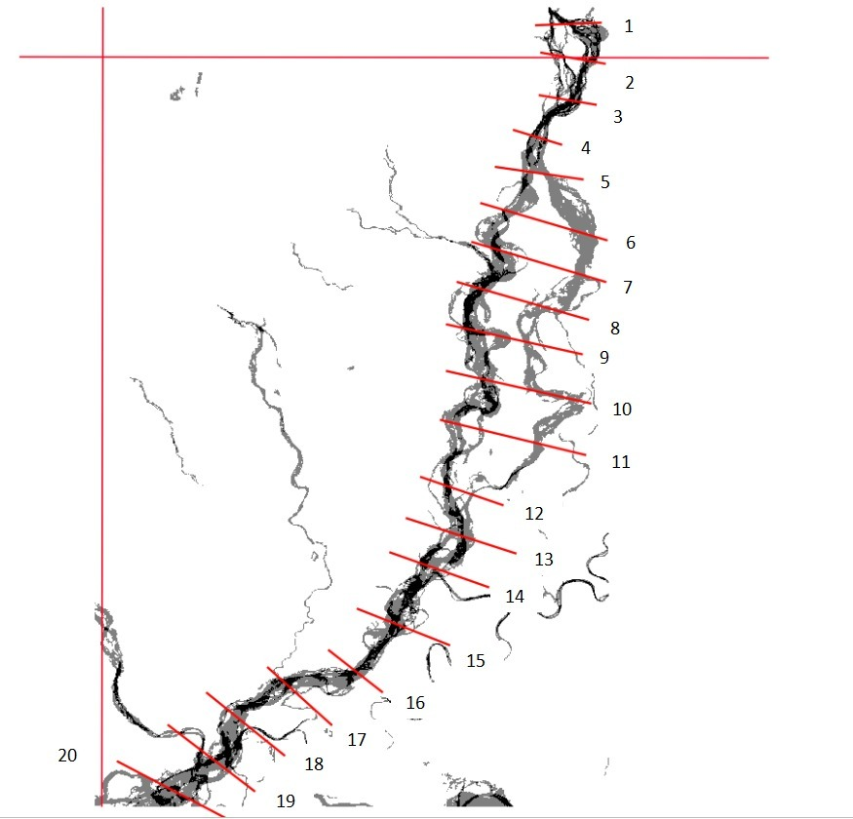
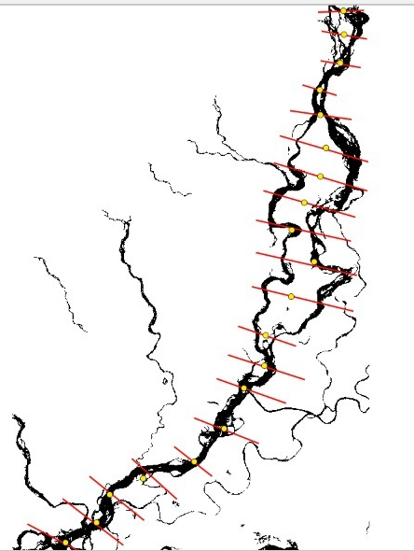
Methodology
Division of Subansiri River into 20 cross sections from 2000 to 2020
Calculating Midline channels
Notes:
After running the code for this process we obtained a .tiff file in the console of the Google Earth Engine and we downloaded all these shapefiles for superimposing the various years of river outline for further analysis. QGIS lets you add multiple layers, so after importing all the different shapefiles as individual layers we stacked them one on top of the other by rearranging the layers year-wise i.e. the base layer representing the year 2000 and the topmost layer representing the year 2019. The assessment of the riverbank location was carried out in 20 phases, with a gap of 1 year from 2000 to 2019 for both the riverbanks. We also created the 20 cross-sections throughout our region of interest by selecting the area with maximum movement of the river channel and this distance was calculated by creating a reference line and calculating the distance of the bank lines from this cross-sections point and computing this value into our dataset as left bank data for a given year and right bank data for a given year.

Slide 38
Year-2000
Year-2020

